Slide 1


GUN VIOLENCE
Brought to you by
Andrei Chaplygin
Edgar Sanchez
Craig Taylor
Kimmay Truong
Notes:
[Click] -> Title and ‘brought by’ appear [Click] -> Team members appear

Slide 2
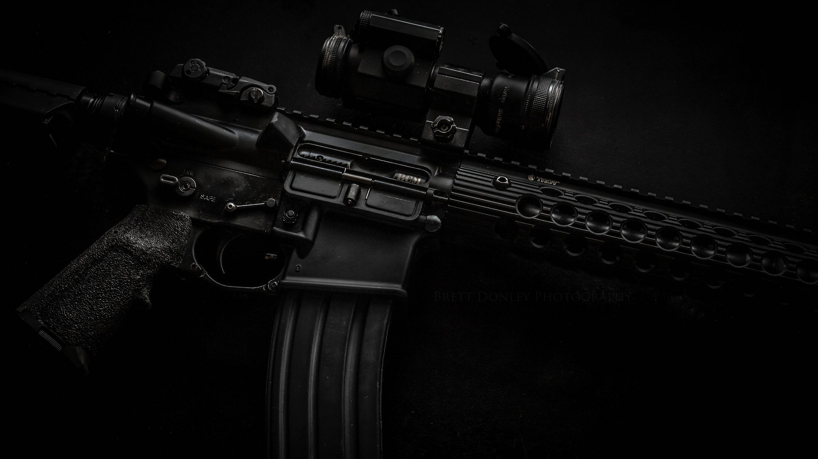
San Bernardino,CA
ORLANDO,FL
Waco,TX
Roseburg,OR
LAS VEGAS,NV
Sutherland Springs, TX
Parkland,FL
Washington Navy Yard,DC
Notes:
[Cities appear] (Narrator) Do you know what these cities have in common? Right, these are the places where the deadliest mass shootings in modern US history happened. Each of them has left its mark on our society and stoke the fire of the never-ending discussion: do we need stricter gun laws? Do more guns prevent more crimes? Can you actually feel safe when a random bystander can carry a gun?
Most of these and similar questions may actually appeal to our emotions but in this project we’ll try to answer some of them using cold hard data

Slide 3
QUESTIONS
Correlation between gun violence and demography? (spoiler: maybe)
Correlation between gun violence and geography? (spoiler: maybe)
Correlation between gun violence and gun laws? (spoiler: maybe)
Correlation between gun violence and its types? (spoiler: indeed)
vs. DATA
Comprehensive data of over 260k US gun violence incidents for 2013-2018 https://www.kaggle.com/jameslko/gun-violence-data
A compilation of gun-related rules and laws per state https://www.gunstocarry.com/gun-laws-state/
A population data https://www.census.gov/data/developers/data-sets/popest-popproj/popest.html
Notes:
[Click] -> Questions appear -> [Narrator] Describe the questions, explain what exactly we mean by “demography” (age of subjects/victims), “geography” (cities and states/state population per capita), “gun laws” (the consolidate gun friendliness rating of each state) “violence types” (explain that there are ‘suicides’, ‘mass shootings’ and ‘self defence’)
[Click] -> Data appear -> [Narrator] Just some general comments on the data

